Slide 1


SAP Full-Stack Developer training
ABAP on HANA, UI5 & Fiori, Analytics with OData
Anubhav Oberoy
Day – 7

Slide 2

Agenda – Day 7
Introduction to OData Services
Consuming Northwind OData Services from UI5 Application
Deployment Options
Deploying Ui App into Fiori Launchpad
Fiori Launchpad Configuration For Tiles

Slide 3

Introduction to OData Services
OData is open data protocol, it is used to create REST based services, initially developed by the OASIS company later acquired by Microsoft and make open source.
REST – Representational State Transfer – also known as STATELESS Communication
OData was developed by Microsoft in 2007 and later they made it open source.
Presentation
Fiori
SAP_UI
http request
response
OData
Software Innovation
Hardware Innovation
Hana
Note: Fiori Only and Only Understand OData.

Slide 4
OData Basic
When we call a service, it loads a service document, a service document includes multiple OData Entity Sets inside. Each service also has a metadata document which explains about properties inside of each entity set.
Service Document (Collection of Entity Sets) – 1 Entity Set = 1 DB Table
https://services.odata.org/V2/(S(gte5obp1xr5gdvcqffzwbrwq))/OData/OData.svc/
Service metadata (/$metadata) – all the entity types and entity sets
Entity Type is the blue print of data set, entity set is the access point of actual data
https://services.odata.org/V2/(S(gte5obp1xr5gdvcqffzwbrwq))/OData/OData.svc/$metadata
Access Multiple Records of an Entity Set (SELECT * FROM dB table)
https://services.odata.org/V2/(S(gte5obp1xr5gdvcqffzwbrwq))/OData/OData.svc/Products?$format=json

Slide 5
Format of an OData URL
http(s)://hostname:port/sap/opu/odata/sap/SERVICENAME_SRV/ENTITYSET?p1=val&p2=val
Protocol
Adress & Port
Path prefix
Service Name
End Point Access Data
Query Options

Slide 6
Client Side Query with OData
02
$top
01
03
$format
$skip
ODATA Query
06
04
$expand
$select
05
$filter

Slide 7
SAP OData V2 (Version 2)
OData v2 is a set of new standards which are add-ons to SAP OData V1, and these are as follows:
Client-side sorting and filtering
All requests can be batched
All data is cached in the model
Automatic Message handling
You can read more about SAP OData v2 vs OData v1 here.
Northwind OData service
Northwind is publicly available OData service. You can use this freely available OData service to learn how to use and consume OData service in SAPUI5 applications with SAP WebIDE.
https://services.odata.org/V2/Northwind/Northwind.svc/
More free OData service: https://services.odata.org/

Slide 8
Consuming Northwind OData service

Slide 9
Title
This is text

Slide 10
Title
This is text

Slide 11

Break

Slide 12
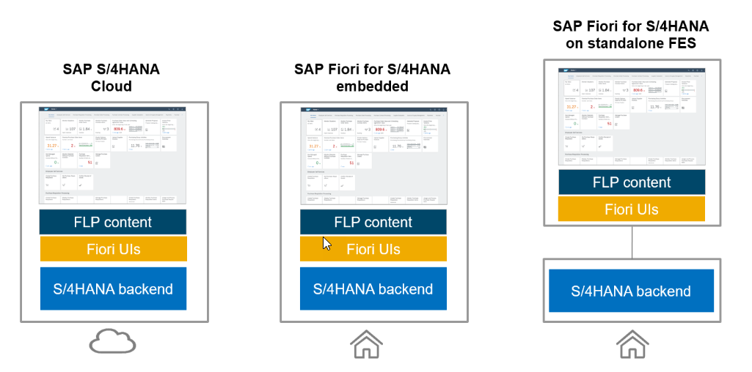
deployment Options

Slide 16

End of Day 2

Slide 17

Questions

Slide 18

Anubhav Oberoy

Slide 19


We’re committed to empower you to be
Most Desirable Resource
through powerful training solutions.
We build the workforce of the future.
250+
Corporate Clients
30,000+
Learners Trained
25000+
Learners Placed
FREE WEBINARS
Sign up for free webinars with industry experts every fortnight!
Enroll Now!
Contact us today!
https://anubhavtrainings.com/

Slide 20




More from AnubhavTrainings.com

